Slide 1

Sandip Foundation’s
Sandip Institute of Engineering and Management
Department of Electronics and Telecommunication Engineering
Academic Year 2023-24
Project Presentation on :
Classification of White Blood Cell Using Machine Learning & Image Processing Model
Guided By -:
Members:-
Prof. (Dr). Mosam.K.Sangole
Nikita Arun Thorat.
Vishal Raghunath Chaudhari.
Kaushal Sachin Lahamge.

Slide 2
CONTENTS
Introduction
Objectives
Problem Statement
Project Requirement
Literature review
Block Diagram
CNN Architecture
Methodology
Datasets
Feature Extraction
Advantage
Result
Conclusion
References

Slide 3
INTRODUCTION
White Blood cells are key players in the immune system of the human body. There are three broad classifications of blood cells- Red Blood Cells (RBC) that transport oxygen, White Blood Cells (WBC) the face of immune system and platelets that trigger blood clotting in damaged tissues. White Blood Cells makes up 1% of the human blood in a healthy human adult. They are present throughout the body and each type of White Blood Cells have a certain functionality in the human body and serves by protecting human body against various infections and diseases. If they detect any of these in the blood, they attack them to counter any potential damage these elements can cause in the body.
The structure of the WBC, predominantly, comprises of a large lobed nucleus that can be used to distinguish a WBC from other blood cell types. Apart from a nucleus, WBC consists of cytoplasm and cell wall.
There are major four categories of WBC in human body. However due to data set constraints we have classified data into four categories: Neutrophil (0.4% approximately), Eosinophil (2.3% approximately), Monocytes (5.3% approximately), Lymphocytes (30% approximately)

Slide 4
OBJECTIVES
To develop a system that utilizes machine learning & image processing algorithms to identify different types of blood cells from microscopic images of blood samples.
The objective is to maintain the accuracy using machine learning & image processing algorithms in medical practices.

Slide 5
PROBLEM STATEMENT
Each year more than half a million people develop cancer or leukemia or born with life- threatening blood disorders such as thalassemia or sickle cell diseases. Our goal is to ensure a machine learning system using Python that is capable of providing information on the diagnosis of blood cell types to help provide reliable treatment for people with blood disorders.

Slide 6
PROJECT REQUIREMENTS
CPU speed 2.4 GHZ
Ram 2 GB
Operating system : windows 10 /11
IDE: Spyder/Jupyter Notebook
Programming language : Python
Dataset: Kaggle dataset

Slide 7
LITERATURE REVIEW
Sr. No. | Title | Author | Year & Publication | Findings
1 | Classification of White Blood Cells Using Machine and Deep Learning Models: A Systematic Review | Rabia Asghar, Sanjay Kumar, Paul Hynds, Arslan Shaukat | 2019: IEEE Journal of Biomedical and Health Informatics | Morphology of blood cell and types of WBCs.
2 | Automatic identifying and counting blood cells in smear images by using single shot detector and Taguchi method | Yao‑Mei Chen, Jinn‑Tsong Tsai, Wen‑Hsien Ho | 2020: From International Conference on Biomedical Engineering Innovation. | Identification of blood cells using machine learning likely revolves around the successful application of machine learning techniques for automating the process of identifying and counting blood cells.

Slide 8
LITERATURE REVIEW
Sr. No. | Title | Author | Year & Publication | Findings
3 | White Blood Cells Image Classification Based on Radiomics and Deep Learning | WENNA WU, SHENGWU LIAO, ZHENTAI LU | 21 November 2022: IEEE | An innovative way to accomplish automatic RBC counting was introduced.
4 | Detection, Classification and Counting RBCs and WBCs Using machine Learning. | Yaswanth Gangula; Abdul Majeed K K. | 2023 Third International Conference on Secure Cyber Computing and Communication (ICSCCC) | CNN algorithm, and features extraction algorithms information.

Slide 9
LITERATURE REVIEW
Sr. No. | Title | Author | Year & Publication | Findings
5 | White Blood Cell Image Classification Using Deep Learning | Neerukattu Indrani, Chiraparapu Srinivasa Rao | 1 September 2021 : International Journal for Modern Trends in Science and Technology | The results of this study add to the increasing body of literature on automated medical image application and highlight the potential of machine learning approaches for changing diagnostic operations in healthcare settings.
6 | Detection and classification of white blood cells with an improved deep learning-based approach. | FATMA AKALIN, NEJAT YUMUŞAK | 11 Jan 2022: Turkish Journal of Electrical Engineering and Computer Sciences. | This automation not only saves time but also reduces the potential for human error, improving the overall efficiency and reproducibility of cell culture experiments.

Slide 10
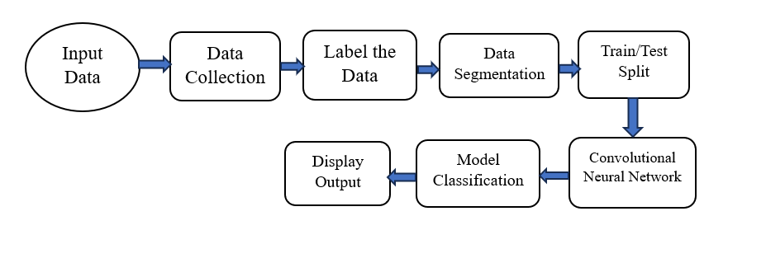
SYSTEM METHODOLOGY

Slide 11
Why the CNN algorithm is used?
Conventional analyzer used to detect the count and range of WBCs through size of grouped cell and it can be misleading.
Therefore, peripheral smears, which are still evaluated manually today, offer the most reliable method for evaluating WBCs.
Therefore, combining the features from different layers of CNN can be beneficial for WBC-type recognition because it provides more discriminative information on WBCs’ structure beyond simply high-layer information.

Slide 12
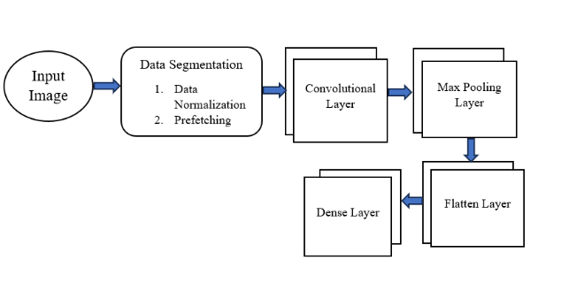
CNN Architecture Block Diagram

Slide 13
FEATURE EXTRACTION
Convolutional Neural Network (CNN)
A Convolutional Neural Network (CNN) architecture is a popular choice for projects involving the classification of white blood cells (WBCs) utilizing machine learning and image processing due to its effectiveness in dealing with microscopic image data.
Data Segmentation: The process of dividing a dataset into subsets or segments based on certain criteria. This segmentation can be done for various purposes, including preprocessing, analysis, or model training.
i. Training Set: Used to train the model.
ii. Testing Set: Used to assess the final performance of the trained model.
iii. Validation Set: Used to tune hyper parameters and evaluate the model’s performance during training

Slide 14
Data Normalization: Data normalization is a preprocessing technique used in machine learning to rescale the values of numerical features to a standard range without distorting differences in the ranges of values.
Here we used the TensorFlow’s Rescaling layer for data normalization. This layer scales input values to be in a specified range, often between 0 and 1.
Rescaling layer that will scale input values by dividing them by 255, effectively bringing them into the [0,1].
Lambda function takes each sample in the training dataset, testing dataset and validation dataset and applies normalization layer. After this normalization step data will be ready to fed into a machine learning model.
Prefetching: Prefetching is a technique used to overlap the data loading process with model training or inference. It's particularly useful when dealing with large datasets that may take significant time to load from storage into memory.

Slide 15
•Convolutional Layer: A convolutional layer is a fundamental building block in convolutional neural networks (CNNs), commonly used in image recognition, computer vision, and other tasks involving grid-like data such as time-series analysis and natural language processing.
2D Convolution: It's a process of applying a filter/kernel to the input image to produce an output feature map. Here we apply 2 pixels strides at time. We set ‘activation’=’relu’ specifies the Rectified Linear Unit (ReLU) activation function, which introduced non-linearity to the model.
2D Max Pooling: Max Pooling 2D is the type of pooling layer commonly used in convolutional neural networks (CNNs) for down sampling feature maps. The size of the pooling window and the stride (step size) at which the window moves across the feature map are 2x2 or 3x3. Here we set pooling window at 2 pixels at a time.
Flatten Layer: The ‘Flatten’ layer in a neural network is used to convert multi-dimensional data into a one-dimensional array. It essentially flattens the input without modifying the batch size.
Dense Layer: In CNN, dense layer is used for extracting hierarchical features from the input data, preserving spatial information, and reducing spatial dimension through down sampling.

Slide 16
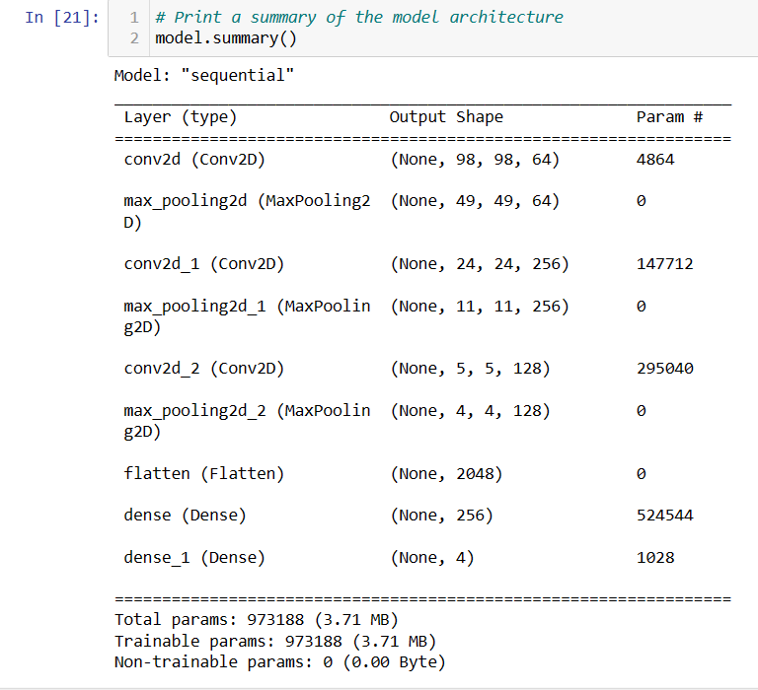
CNN Model Summary Output

Slide 17
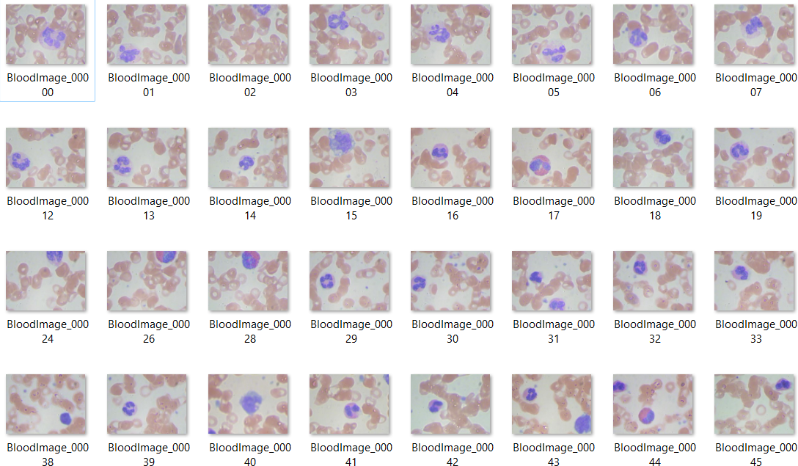
Dataset
In our project we have use microscopic cell samples images Kaggle dataset.
In dataset there are three sub folder name train, test, val.

Slide 18
ADVANTAGES
Non-Invasive: Image processing techniques provide a non-invasive way to detect WBCs and its types, reducing the need for invasive procedures and minimizing patient discomfort.
Early Detection: Image processing can detect WBC and its types at an early stage, allowing for timely medical intervention and better outcomes for patients.
Accuracy: Modern image processing algorithms offer high accuracy in identifying cell, aiding healthcare professionals in making accurate treatment.
Visual Representation: Images provide a visual representation of the fracture, helping medical practitioners visualize the extent and nature of the injury.

Slide 19
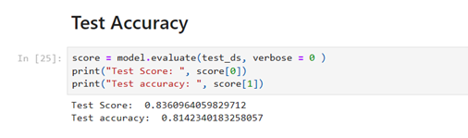
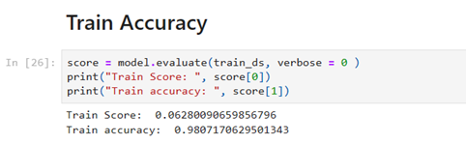
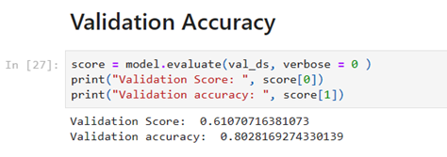
RESULT- Comparative Result

Slide 20
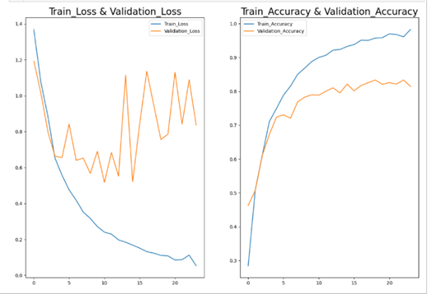
Graphical Representation of Loss & Accuracy:

Slide 21
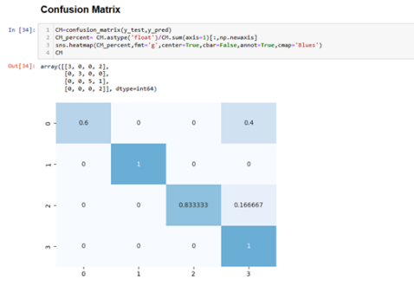
Fig: Confusion Matrix

Slide 22
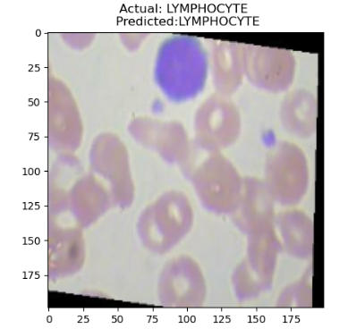
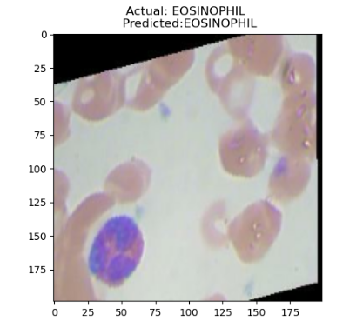
Fig : Cell Identification

Slide 23
REFERENCE
[1] Altaf Khan a*, Amber Eker b, Alexander Chefranov a, Hasan Demirel c a Department of Computer Engineering, Eastern Mediterranean University, Mersin, Turkey b Faculty of Medicine, Eastern Mediterranean University, Mersin, Turkey c Department of Electrical & Electronics Engineering, Eastern Mediterranean University, Mersin, Turkey.
[2] Oumaima Saidani1, Muhammad Umer2, NazikAlturki1, AmalAlshardan1, Muniba Kiran3, ShtwaiAlsubai4, Tai‑Hoon Kim5* & ImranAshraf6.
[3] Changhun Jung1, Mohammed Abuhamad2, David Mohaisen3, Kyungja Han4 and DaeHun Nyang1*.
[4] Mu-Chun Su,1 Chun-Yen Cheng,1 and Pa-Chun Wang2 1 Department of Computer Science & Information Engineering, National Central University, Jhongli 32001, Taiwan 2General Hospital, Taipei 10656, Taiwan.
[5] Khamael AL-Dulaimi1, *, Jasmine Banks1, Vinod Chandran1, Inmaculada Tomeo-Reyes2 and Kien Nguyen1 1 School of Electrical Engineering and Computer Science, Queensland University of Technology, QLD, Australia 2 School of Electrical Engineering and Telecom.
[6] Abdullah Elen *1, M. Kamil Turan 2 1 Karabük University, Dept. of Comp. Tech., Vocational School of T.O.B.B. Tech. Sci., 78050 Karabük, TURKEY 2 Department of Medical Biology, Faculty of Medicine, Karabük University, 78050 Karabük, TURKEY.
[7] Made Satria Wibawa Department of Information System STMIK STIKOM BALI Denpasar, Indonesia.

Slide 24
[8] SIRAJ KHAN1, MUHAMMAD SAJJAD 1,2, TANVEER HUSSAIN 3, (Student Member, IEEE), AMIN ULLAH 3, (Member, IEEE), AND ALI SHARIQ IMRAN 2, (Member, IEEE) 1Digital Image Processing Laboratory, Department of Computer Science, Islamia College University Peshawar, Peshawar 25000, Pakistan 2Department of Computer Science, Norwegian University of Science and Technology (NTNU), Gjøvik, Norway 3 Intelligent Media Laboratory, Department of Software, Sejong University, Seoul 143-747, South Korea.
[9] Da Wang1†, Maxwell Hwang1†, Wei‑Cheng Jiang2re, Kefeng Ding1*, Hsiao Chien Chang3 and Kao‑Shing Hwang3 From International Conference on Biomedical Engineering Innovation 2019 Kaohsiung, Taiwan. 15-19 November 2019.
[10] Irwan Rahadi1, Meechoke Choodoung2, and Arunsri Choodoung3 1Department of Statistics, Universitas Hamzanwadi, Lombok, Indonesia 2Department of Mathematics, Mahidol University, Bangkok, Thailand 3Center of Medical Laboratory Service, Mahidol University, Bangkok, Thailand.
[11] Hua Chen1, Juan Liu1*, Chunbing Hua1, Jing Feng1 , Baochuan Pang2 , Dehua Cao2 and Cheng Li.
[12] WENNA WU 1,2,3, SHENGWU LIAO4, AND ZHENTAI LU1,2,3, (Member, IEEE) 1School of Biomedical Engineering, Southern Medical University, Guangzhou 510515, China.
[13] Neerukattu Indrani1, Chiraparapu Srinivasa Rao2 1PG Scholar, Department of Computer Science, SVKP & Dr K S Raju Arts & Science College, Penugonda, W.G.Dt., A.P, India. 2Associate Professor in Computer Science, SVKP & Dr K S Raju Arts & Science College, Penugonda, W.G.Dt., A.P, India.
[14] Anwar Siswanto1, Abdul Fadlil2, Anton Yudhana3 1 Informatics Engineering Master Program, Universitas Ahmad Dahlan, Yogyakarta, Indonesia 23Departement of Electrical Engineering, Universitas Ahmad Dahlan, Yogyakarta, Indonesia.
[15] César Cheuque 1, Marvin Querales 2, Roberto León 1, Rodrigo Salas 3,4 and Romina Torres 1,4, *.

Slide 25
Thank You !

